Slide 1

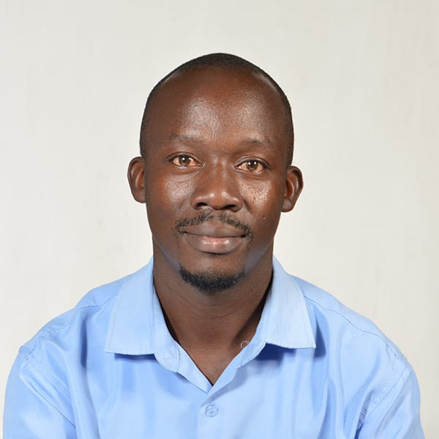

Title: Screening for Tuberculosis among clients who accessed HIV Testing Services at Umoja Health Centre, Nairobi, Kenya: a cross-section observational study.
Head Shot
SIMON MONG’ARE,
BSc. Public Health
Umoja Health Centre, Nairobi, Kenya.

Slide 2
Authors and Affiliation
Authors:
S. Mong’are¹, M. Abdullahi¹, A. Ngano¹, E. Mogaka¹, G. Wairimu¹, D. Odok²,
C. Ngunu³
Affiliations:
¹Umoja Health Centre, Nairobi, Kenya.
²Embakasi West Sub county, Nairobi, Kenya.
³Nairobi City County, Kenya.

Slide 3
Introduction
In 2024, estimates shows that 40% of Tuberculosis (TB) cases remain undiagnosed and untreated among the population leading to a burden in Kenya.
Integrating TB screening in HIV testing services is a crucial intervention which can enhance early case detection thus reducing transmission.
This study aimed to assess screening rate of TB among clients who accessed HIV Testing Services at Umoja Health Centre.

Slide 4
Methodology
A cross-section observational study was conducted among 17,032 clients who accessed HIV Testing Services between October 2022 and May 2025 at Umoja Health Centre, Nairobi, Kenya.
Tuberculosis Screening Assessment Tool was used to screen signs including (Cough of any duration, fever, noticeable weight loss, night sweat) and presumptive DR TB register was used to document those with signs, No TB signs, Presumed TB, TB Confirmed and TB Screening not done.
Data collected was analyzed using Microsoft Excel.

Slide 5
Results 1/5: Total Number of clients screened, Presumed and Confirmed with TB

Slide 6
Results 2/5: Total Number Presumed TB according to gender

Slide 7
Results 3/5: Total Number Confirmed with TB according to gender

Slide 8
Results 4/5: Presumed TB with HIV status

Slide 9
Results 5/5: Total confirmed TB with HIV status

Slide 10
Conclusion
Overall, males contributed highest TB cases as compared to females while clients with confirmed TB had the highest HIV positivity as compared those who were presumed.
Regular TB screening during HIV testing should be prioritized to enable timely identification and treatment among TB confirmed individuals and preventing progression to severe disease hence improving health outcomes.

Slide 11
Acknowledgement
1. Nairobi City County- SHINE Project.
2. Embakasi West Subcounty.
3. Umoja Health Centre.
4. IPNET-Kenya.

